Slide 1
Contraceptive Methods

Slide 2
Contraception
There are many types of contraception widely used now days for family planning purposes.
Each method has its advantages and suits special cases and not necessarily suits others and the choice of contraception depends on different needs of the patients like the period of contraception and also doctor should decide which method suits needs more.
No method of contraception is completely effective.
Types:-
  Natural contraception
  Mechanical contraception
  Hormonal contraception
  Surgical contraception

Slide 3
Characteristics of ideal contraceptive:
Safe
100% effective
Free of side effects
Easily obtainable
Affordable
Acceptable to the user
Free of effects on future pregnancies

Slide 4
Types of Birth Control
Hormonal
Barrier
IUD
Methods based on information
Permanent sterilization

Slide 5
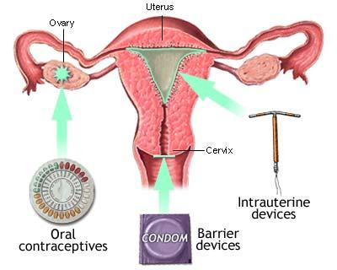
Types of Birth Control

Slide 6
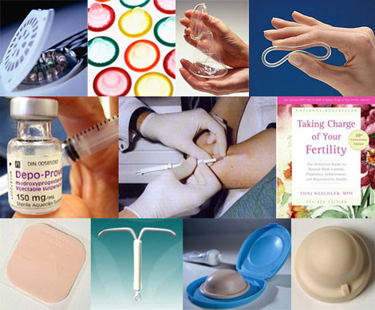
Types of Birth Control

Slide 7
Hormonal Methods
Oral Contraceptives
(Birth Control Pill)
Injections (Depo-Provera)
Implants (Norplant I & II)

Slide 8
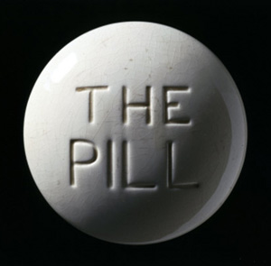
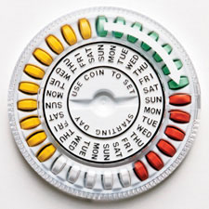
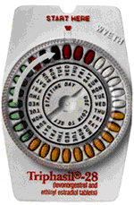
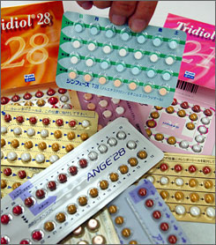
Birth Control Pills
Pills can be taken to prevent pregnancy
Pills are safe and effective when taken properly
Pills are over 99% effective

Slide 9
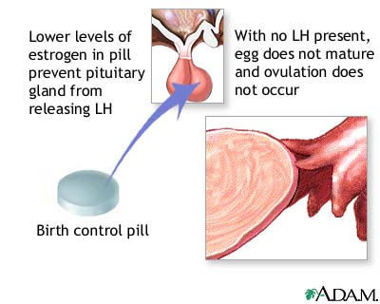
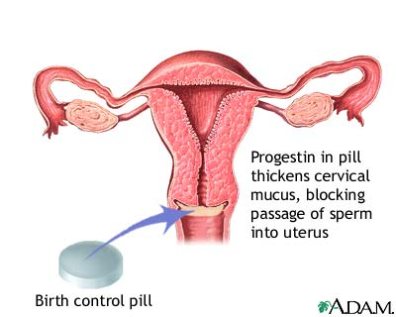
How does the pill work?
Stops ovulation
Thins uterine lining
Thickens cervical mucus

Slide 10
Positive Benefits of Birth Control Pills
  Prevents pregnancy
  Eases menstrual cramps
  Shortens period
  Regulates period
  Decreases incidence of ovarian cysts
  Prevents ovarian and uterine cancer
  Decreases acne

Slide 11
Side-effects
Breast tenderness
Nausea
Increase in headaches
Moodiness
Weight change

Slide 12
Taking the Pill
Once a day at the same time everyday
Use condoms for first month
Use condoms when on antibiotics
Use condoms for 1 week if you miss a pill or take one late
The pill offers no protection from STD’s

Slide 13
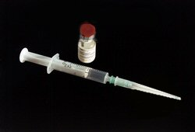
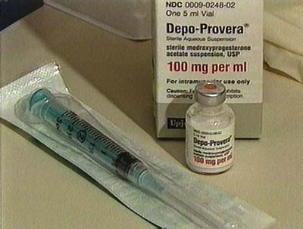
Depo-Provera
Birth control shot given once every three months to prevent pregnancy
99.7% effective preventing pregnancy
No daily pills to remember

Slide 14
How does the shot work?
The same way as the Pill!
Stops ovulation
Stops menstrual cycles!!
Thickens cervical mucus

Slide 15
SIDE EFFECTS
Extremely irregular menstrual bleeding and spotting for 3-6 months!
NO PERIOD ☺ after 3-6 months
Weight change
Breast tenderness
Mood change
*NOT EVERY WOMAN HAS SIDE-EFFECTS!

Slide 16
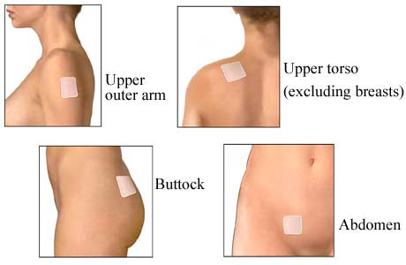
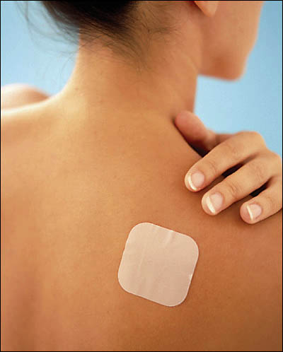
The Patch

Slide 17
IMPLANTS
Implants are placed in the body filled with hormone that prevents pregnancy
Physically inserted in simple 15 minute outpatient procedure
Plastic capsules the size of paper matchsticks inserted under the skin in the arm
99.95% effectiveness rate

Slide 18
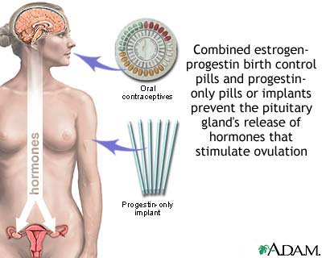
Norplant I vs. Norplant II
Six capsules
Five years
Two capsules
Three years
The pill works in several ways to prevent pregnancy. The pill suppresses ovulation so that an egg is not released from the ovaries, and changes the cervical mucus, causing it to become thicker and making it more difficult for sperm to swim into the womb. The pill also does not allow the lining of the womb to develop enough to receive and nurture a fertilized egg. This method of birth control offers no protection against sexually-transmitted diseases.

Slide 19
Norplant Considerations
Should be considered long term birth control
Extremely effective in pregnancy prevention > 99%

Slide 20
Emergency contraception pills can reduce the chance of a pregnancy by 75% if taken within 72 hours of unprotected sex!
Emergency Contraception

Slide 21
Emergency Contraception (ECP)
Must be taken within 72 hours of the act of unprotected intercourse or failure of contraception method
Must receive ECP from a physician
75 – 84% effective in reducing pregnancy

Slide 22
ECP
Floods the ovaries with high amount of hormone and prevents ovulation
Alters the environment of the uterus, making it disruptive to the egg and sperm
Two sets of pills taken exactly 12 hours apart

Slide 23
BARRIER METHODS
Spermicides
Male Condom
Female Condom
Diaphragm
Cervical Cap

Slide 24
BARRIER METHOD
Prevents pregnancy blocks the egg and sperm from meeting
Barrier methods have higher failure rates than hormonal methods due to design and human error

Slide 25
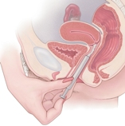
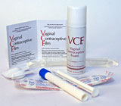
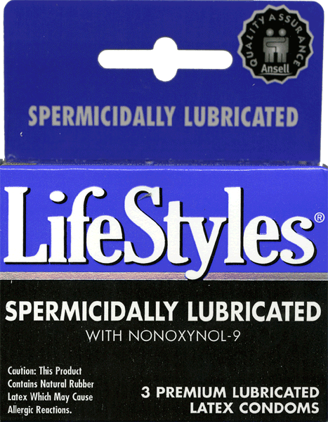
SPERMICIDES
Chemicals kill sperm in the vagina
Different forms:
-Jelly -Foam -Suppository
Some work instantly, others require pre-insertion
Only 76% effective (used alone), should be used in combination with another method i.e., condoms

Slide 26
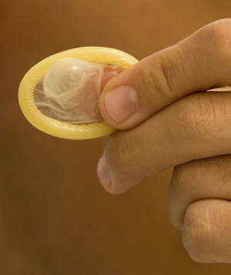
MALE CONDOM
Most common and effective barrier method when used properly
Latex should only be used in the prevention of pregnancy and spread of STI’s (including HIV)

Slide 27
MALE CONDOM
Typical effectiveness rate = 88%
available
Combining condoms with spermicides raises effectiveness levels to 99%

Slide 28
FEMALE CONDOM
Made as an alternative to male condoms
Polyurethane
Physically inserted in the vagina
Typical rate = 79%
Woman can use female condom if partner refuses

Slide 29
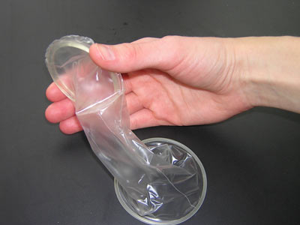
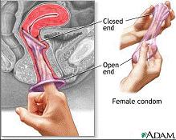
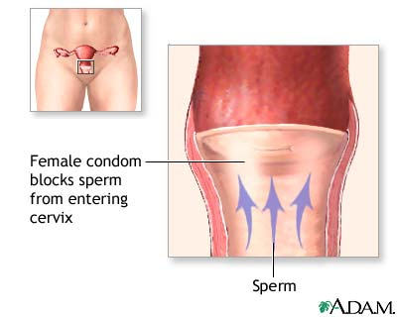
The Female Condom
The female condom is a lubricated polyurethane sheath, similar in appearance to a male condom. It is inserted into the vagina. The closed end covers the cervix. Like the male condom, it is intended for one-time use and then discarded.
The sponge is inserted by the woman into the vagina and covers the cervix blocking sperm from entering the cervix. The sponge also contains a spermicide that kills sperm. It is available without a prescription.

Slide 30
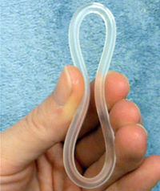
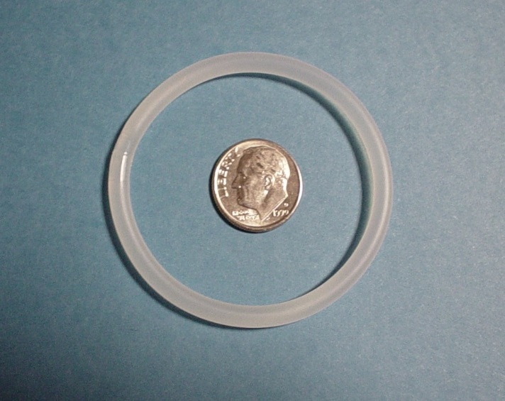
Vaginal Ring (NuvaRing)
95-99% Effective A new ring is inserted into the vagina each month
Does not require a "fitting" by a health care provider, does not require spermicide, can make periods more regular and less painful, no pill to take daily, ability to become pregnant returns quickly when use is stopped.
Nuva Ring is a flexible plastic (ethylene-vinyl acetate copolymer) ring that releases a low dose of a progestin and an estrogen over 3 weeks.

Slide 31
DIAPRAGHM
Typical Effectiveness Rate = 80%
Latex barrier placed inside vagina during intercourse
Fitted by physician
Spermicidal jelly before insertion
Inserted up to 18 hours before intercourse and can be left in for a total of 24 hours

Slide 32
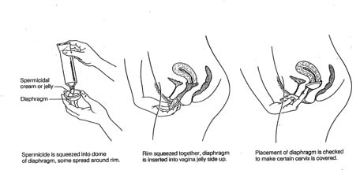
DIAPHRAGM

Slide 33
CERVICAL CAP
Latex barrier inserted in vagina before intercourse
“Caps” around cervix with suction
Fill with spermicidal jelly prior to use
Can be left in body for up to a total of 48 hours
Must be left in place six hours after sexual intercourse
Perfect effectiveness rate = 91%
Typical effectiveness rate = 80%

Slide 34
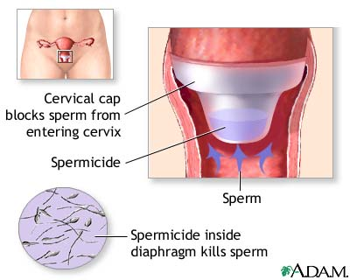
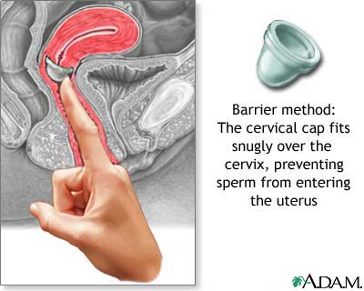
Cervical Cap
The cervical cap is a flexible rubber cup-like device that is filled with spermicide and self-inserted over the cervix prior to intercourse. The device is left in place several hours after intercourse. The cap is a prescribed device fitted by a health care professional and can be more expensive than other barrier methods, such as condoms.

Slide 35
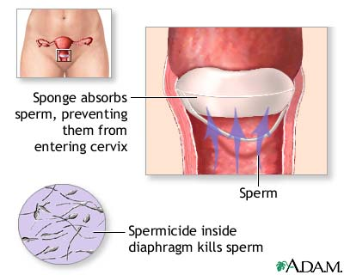
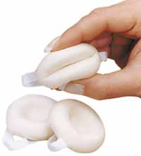
Sponge
The sponge is inserted by the woman into the vagina and covers the cervix blocking sperm from entering the cervix. The sponge also contains a spermicide that kills sperm. It is available without a prescription

Slide 36
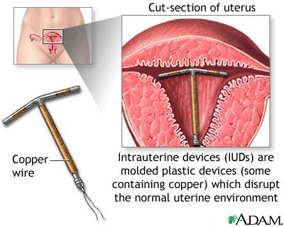
INTRAUTERINE DEVICES (IUD)
T-shaped object placed in the uterus to prevent pregnancy
Must be on period during insertion
A Natural childbirth required to use
IUD
Extremely effective without using hormones > 97 %
The intrauterine device (IUD) shown uses copper as the active contraceptive, others use progesterone in a plastic device. IUDs are very effective at preventing pregnancy (less than 2% chance per year for the progesterone IUD, less than 1% chance per year for the copper IUD). IUDs come with increased risk of ectopic pregnancy and perforation of the uterus and do not protect against sexually transmitted disease. IUDs are prescribed and placed by health care providers.

Slide 37
INTRAUTERINE DEVICES (IUD)
T-shaped object placed in the uterus to prevent pregnancy
Must be on period during insertion
Extremely effective without using hormones > 97 %

Slide 38
Copper T vs.. Progestasert
10 years
99.2 % effective
Copper on IUD acts as spermicide, IUD blocks egg from implanting
1 year
98% effective
T shaped plastic that releases hormones over a one year time frame
Thickens mucus, blocking egg

Slide 39
STERILIZATION
Procedure performed on a man or a woman permanently sterilizes
Female = Tubal Ligation
Male = Vasectomy

Slide 40
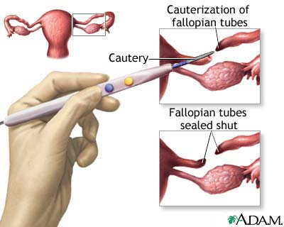
TUBAL LIGATION
Surgical procedure performed on a woman
Fallopian tubes are cut, tied, cauterized, prevents eggs from reaching sperm
Failure rates vary by procedure, from 0.8%-3.7%
May experience heavier periods
Surgical sterilization which permanently prevents the transport of the egg to the uterus by means of sealing the fallopian tubes is called tubal ligation, commonly called "having one's tubes tied." This operation can be performed laparoscopically or in conjunction with a Cesarean section, after the baby is delivered. Tubal ligation is considered permanent, but surgical reversal can be performed in some cases

Slide 41
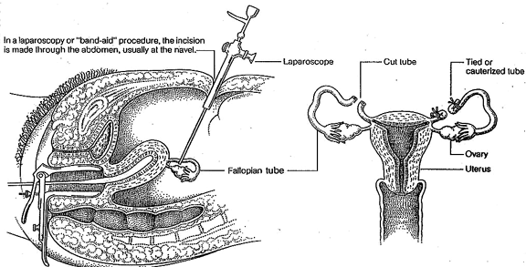
LAPAROSCOPY-’BAND-AID’ STERILIZATION

Slide 42
VASECTOMY
Male sterilization procedure
Ligation of Vas Deferens tube
Faster and easier recovery than a tubal ligation
Failure rate = 0.1%, more effective than female sterilization

Slide 43
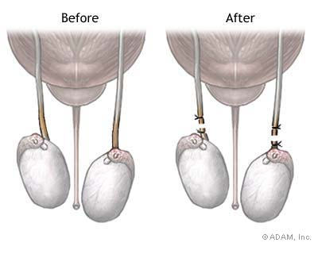
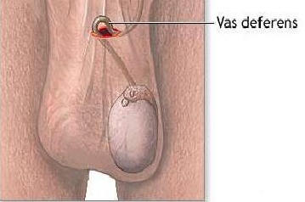
During a vasectomy (“cutting the vas”) a urologist cuts and ligates (ties off) the ductus deferens. Sperm are still produced but cannot exit the body. Sperm eventually deteriorate and are phagocytized. A man is sterile, but because testosterone is still produced he retains his sex drive and secondary sex characteristics.

Slide 44

METHODS BASED ON INFORMATION
Withdrawal
Natural Family Planning
Fertility Awareness Method
Abstinence

Slide 45
Natural Family Planning & Fertility Awareness Method
Women take a class on the menstrual cycle to calculate more fertile times
NFP abstains from sex during the calculated fertile time
FAM uses barrier methods during fertile time
Perfect effectiveness rate = 91%
Typical effectiveness rate = 75%
No 100% safe day-irregular periods

Slide 46
EXCELLENT REFERENCE :
www.plannedparenthood.org/bc Hatcher, Robert, MD
Contraceptive Technology ,17ed. (2001)

